Slide 1
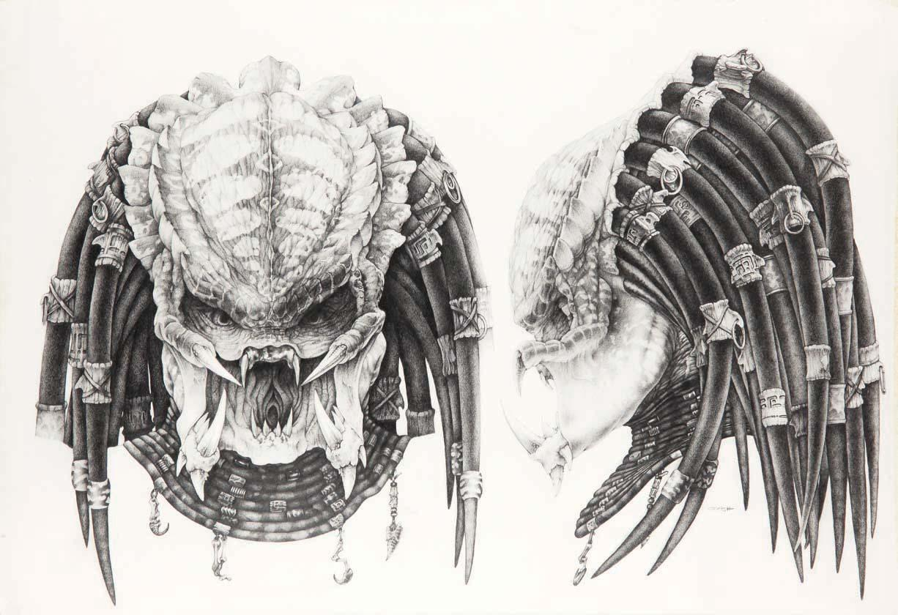
Project 8: Lotka-Volterra predator-prey equations
Tyler Schlichenmeyer
Dylan Sylvester
George Torsilieri
J.D. Smith

Slide 2
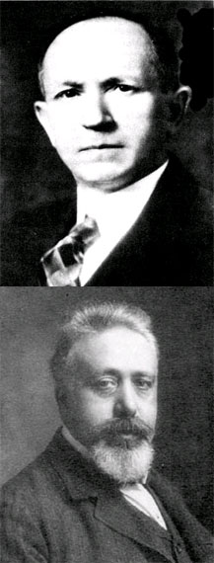
Lotka-Volterra
Developed in 1910
Used in autocatalytic chemical reactions
1920: used to model “organic systems”
1925: Predator-Prey model
http://www.bioquest.org/esteem/esteem_details.php?product_id=203
Notes:
Organic systems- plant and herbivore for example

Slide 3
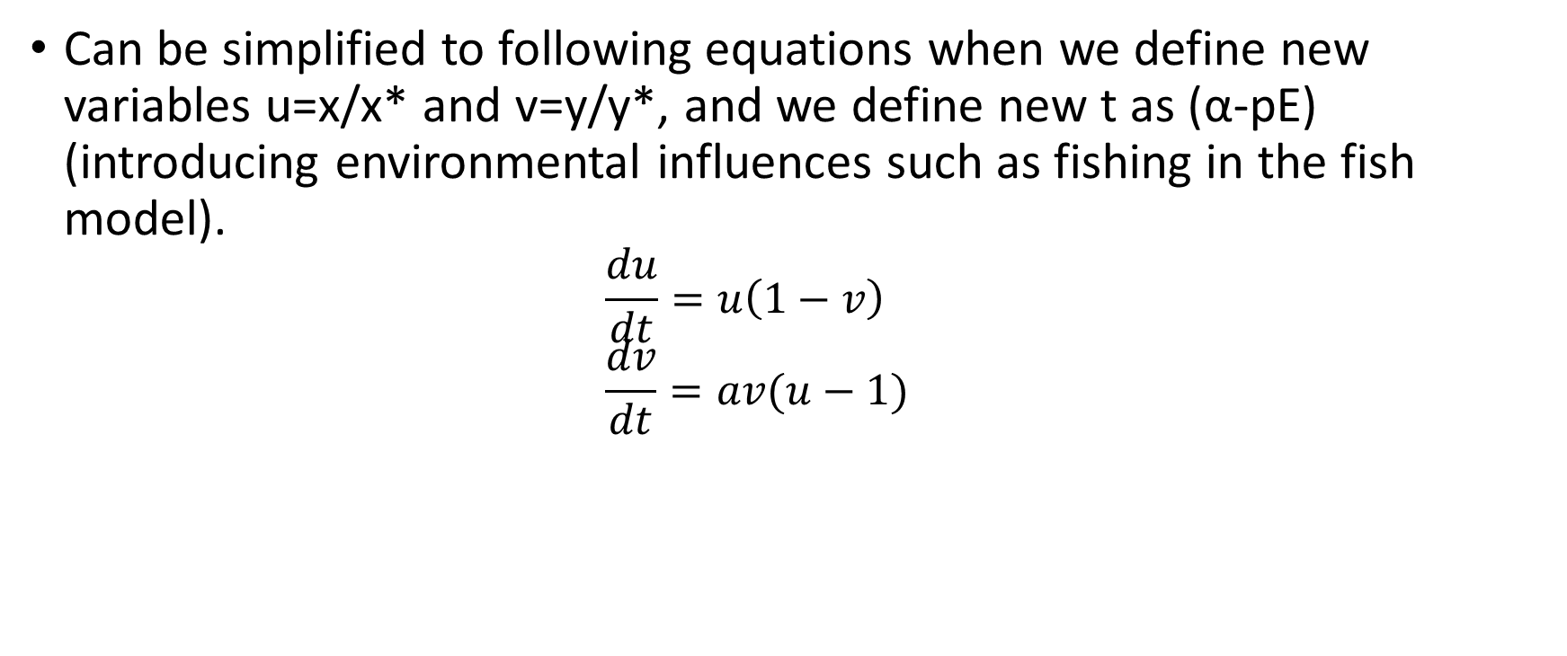
Explanation of original Lotka-Volterra model
Can be simplified to following equations when we define new variables u=x/x* and v=y/y*, and we define new t as (α-pE) (introducing environmental influences such as fishing in the fish model).
$$\frac{du}{dt}=u\left(1−v\right) \\ \frac{dv}{dt}=av(u−1)$$

Slide 4
Problems With the Model
The prey is only limited by the predator
Predation is linearly proportional to the amount of prey
Predators do not have to find prey
Predator dies exponentially in absence of prey
For every prey death a predator is created
Notes:
Really best for biomass…. Or zombies

Slide 5
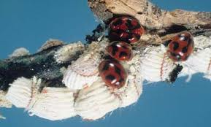

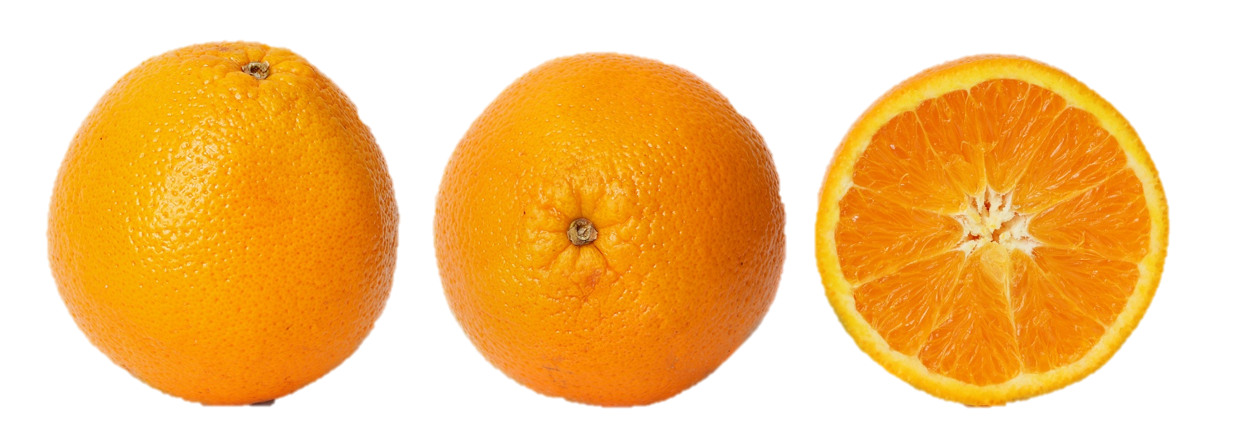
Cottony Cushion Scale Insect vs. Lady Bug
Australia → Florida
Controlled with lady bugs
Population increased with use of DDT
http://entnemdept.ufl.edu/creatures/fruit/cottony_cushion02.jpg
http://jiminmontana.wordpress.com/2012/01/15/environmentalism-the-green-religion-of-dehumanization/

Slide 6
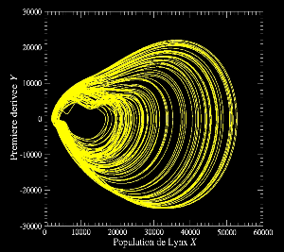
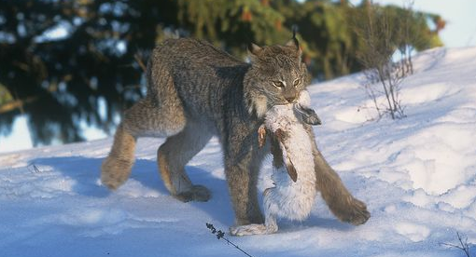
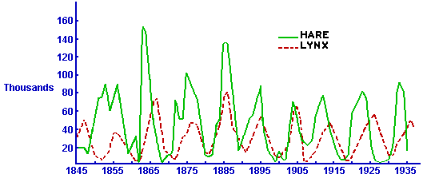
Snow Shoe Hare vs. Lynx
Pelts sold to Hudson Bay Company of Canada 1840-1907
http://www.atomosyd.net/spip.php?article39
http://math.duke.edu/
http://www.arkive.org/snowshoe-hare/lepus-americanus/image-G61724.html

Slide 7
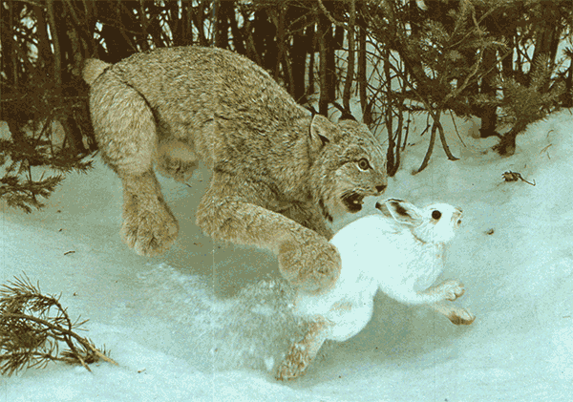
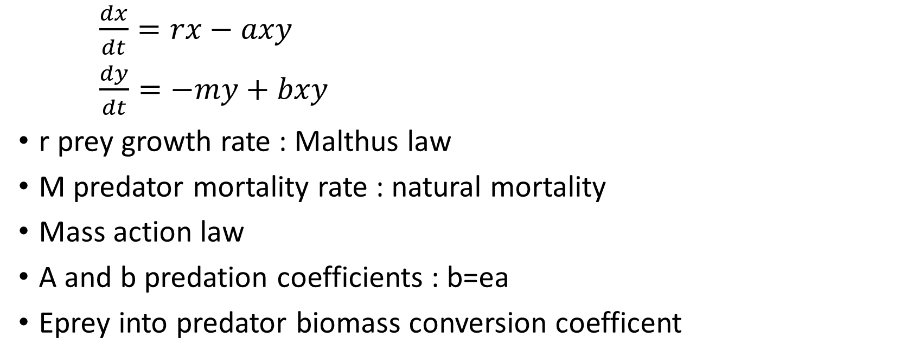
Original Lotka-Volterra
$\frac{dx}{dt}=rx−axy$
$\frac{dy}{dt}=−my+bxy$
r prey growth rate : Malthus law
M predator mortality rate : natural mortality
Mass action law
A and b predation coefficients : b=ea
Eprey into predator biomass conversion coefficent
http://www.sci-fi-o-rama.com/wp-content/uploads/2008/12/lynx_and_hare.png

Slide 8
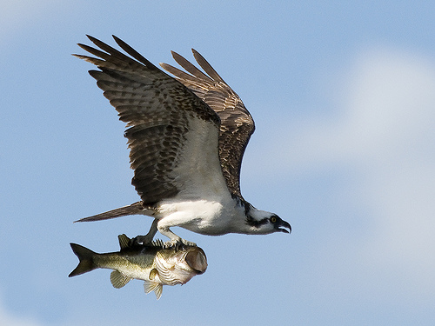
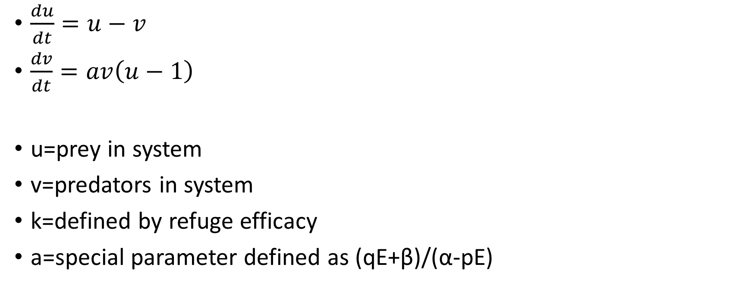
Modified Lotka-Volterra (with refuge)
$\frac{du}{dt}=u−v$
$\frac{dv}{dt}=av\left(u−1\right)$
u=prey in system
v=predators in system
k=defined by refuge efficacy
a=special parameter defined as (qE+β)/(α-pE)
http://staff.slcschools.org/rdahl/data/_uploaded/8th/Predator%20Prey%20Lab/predator1.jpg
E introduces outside influences (fishing)
Rate of increase of prey in absence of predators

Slide 9
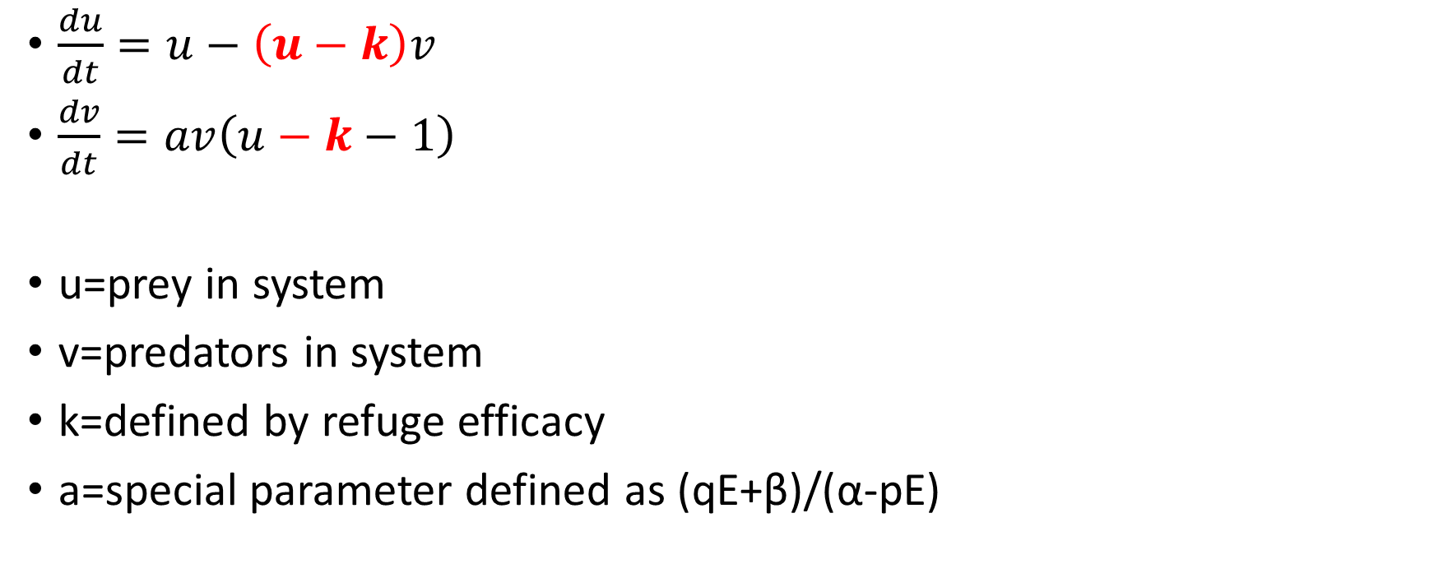
Modified Lotka-Volterra (with refuge)
$\frac{du}{dt}=u−\left(u−k\right)v$
$\frac{dv}{dt}=av\left(u−k−1\right)$
u=prey in system
v=predators in system
k=defined by refuge efficacy
a=special parameter defined as (qE+β)/(α-pE)
E introduces outside influences (fishing)
Rate of increase of prey in absence of predators

Slide 10
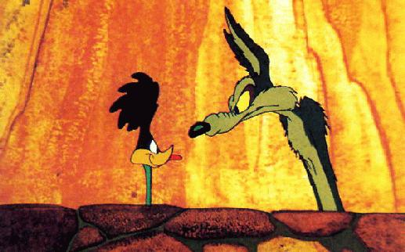
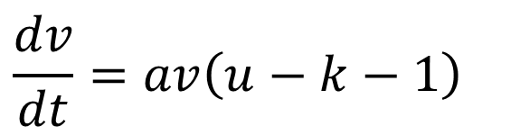

Steady state analysis
$$\frac{du}{dt}=u−\left(u−k\right)v$$
$$\frac{dv}{dt}=av\left(u−k−1\right)$$
http://home.apu.edu/~jsimons/Bio101/coyote.jpg

Slide 11


Steady state analysis
$$0=u−\left(u−k\right)v$$
$$0=av\left(u−k−1\right)$$

Slide 12


Steady state analysis
$$0=0−\left(0−k\right)0$$
$$0=a0\left(0−k−1\right)$$
(steady state 0,0 is trivial)

Slide 13




Steady state analysis
$$0=u−\left(u−k\right)v$$
$$0=av\left(u−k−1\right)$$
$$0=(k+1)−\left(k+1−k\right)v$$
$$u=k+1$$
$$v=k+1$$
Nontrivial steady state= (k+1,k+1)

Slide 14
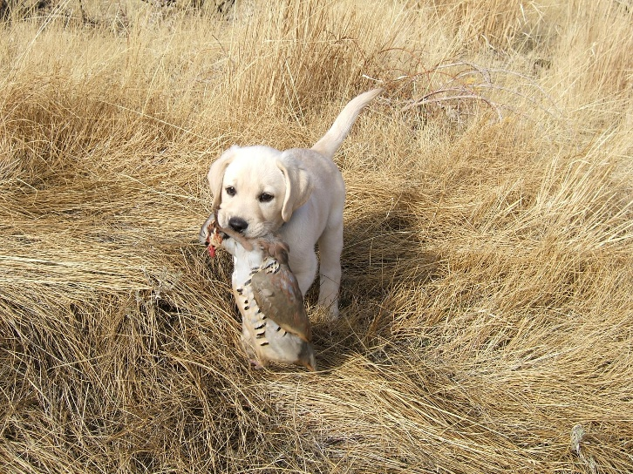

Stability analysis
$$\frac{du}{dt}=u−\left(u−k\right)v$$
$$\frac{dv}{dt}=av\left(u−k−1\right)$$

Slide 15

Stability analysis
$$f=u−\left(u−k\right)v$$
$$g=av\left(u−k−1\right)$$

Slide 16

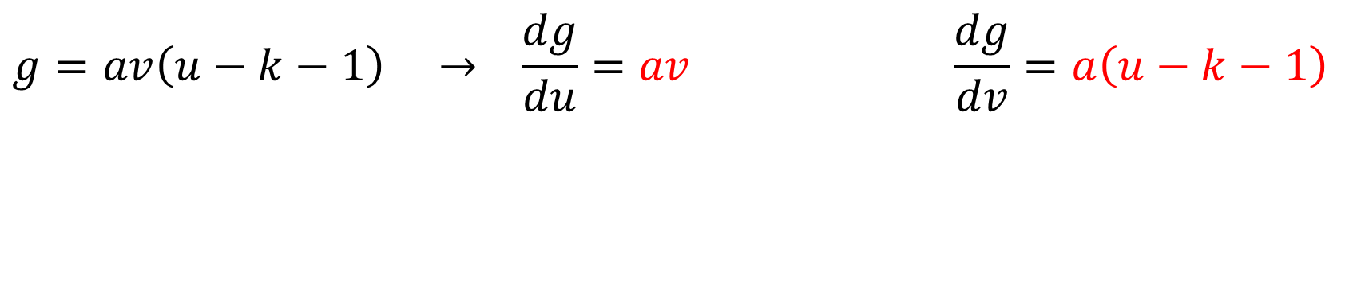
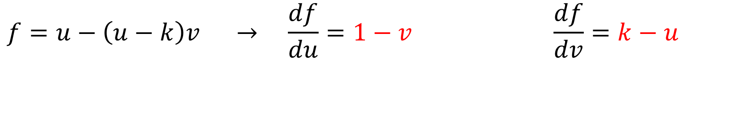
Stability analysis
$$f=u−\left(u−k\right)v → \frac{df}{du}=1−v \frac{df}{dv}=k−u$$
$$g=av\left(u−k−1\right) → \frac{dg}{du}=av \frac{dg}{dv}=a\left(u−k−1\right)$$

Slide 17
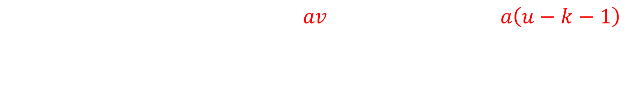
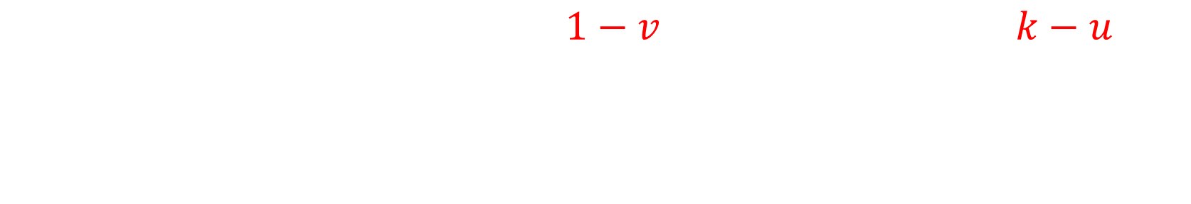
Stability analysis
Jacobian matrix
$$1−v k−u$$
$$av a\left(u−k−1\right)$$

Slide 18
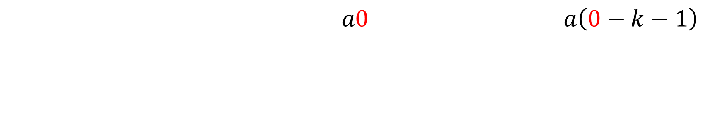
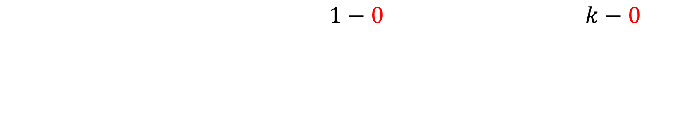
Stability analysis
Trivial stability
$$1−0 k−0$$
?
Trace=1-ak-a
Determinant= -ak-1
Stability cannot be fully determined from this analysis, but trivial anyways
-
$$a0 a\left(0−k−1\right)$$

Slide 19
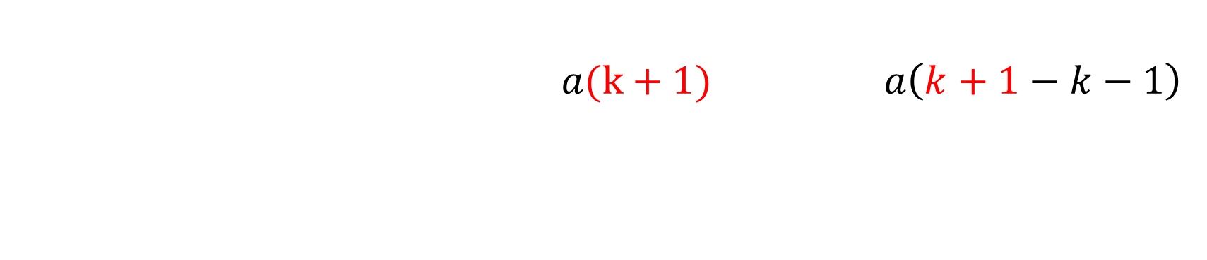
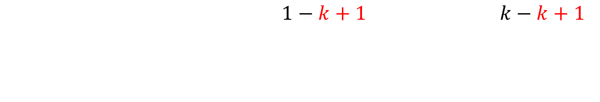
Stability analysis
Nontrivial stability
$1−k+1 k−k+1$
Trace= -k -
Determinant= a(k+1)
+
-Stable node/spiral node
$$a(k+1) a\left(k+1−k−1\right)$$

Slide 20
Stability analysis
Because the nontrivial steady state is stable, populations will tend to gravitate towards the steady state
Because the trivial steady state can be considered unstable, the populations will not be driven to extinction

Slide 21
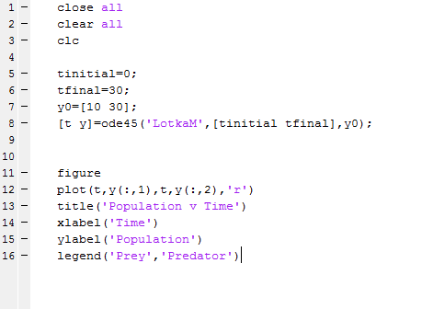
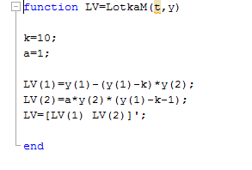
Matlab analysis

Slide 22
Matlab analysis (a=1, k=10)
U(0)=10
V(0)=30

Slide 23
Matlab analysis (a=1, k=10)
U(0)=20
V(0)=30

Slide 24
Matlab analysis (a=1, k=10)
U(0)=5
V(0)=9

Slide 25
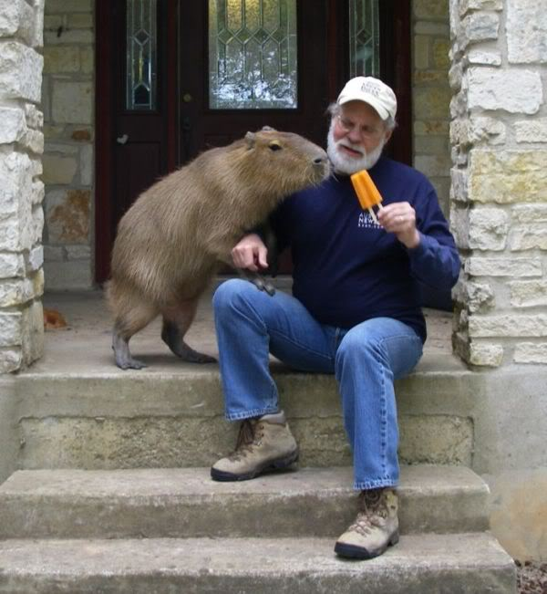
Questions?

